Slide 1
Library Management System

Slide 2
Library Management System
Overview
Core Functionalities
Use case diagram
Class diagram

Slide 3
Overview
A Library Management System (LMS) is a perfect example of how object-oriented programming (OOP) principles can be applied to model a real-world system.
An LMS is essentially a digital tool that streamlines and automates various library processes.
It helps librarians efficiently organize,track, and manage library resources, while also providing patrons with easy access to information and materials.

Slide 4
Core Functionalities
Book Management
01
Adding, editing, and deleting book records.
02
Cataloging books with details like ISBN, title, author, publication date, genre, and subject.
03
Maintaining book inventory and availability status.

Slide 5
Core Functionalities
Member Management
01
Registering new members and updating member information.
02
Managing member types (students, faculty, staff, public).
03
Tracking membership expiration and renewal.

Slide 6
Core Functionalities
Circulation Management
01
Issuing, renewing, and returning books.
02
Generating overdue notices and calculating fines.
03
Placing holds on books.

Slide 7
Core Functionalities
Cataloging and Search
01
Creating and maintaining a library catalog.
02
Providing search functionalities for books, members, and other library resources.

Slide 8
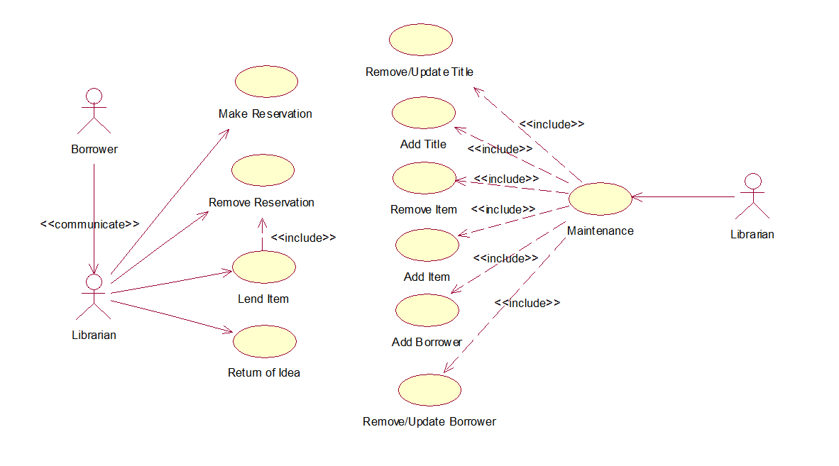
Use Case Diagram

Slide 9
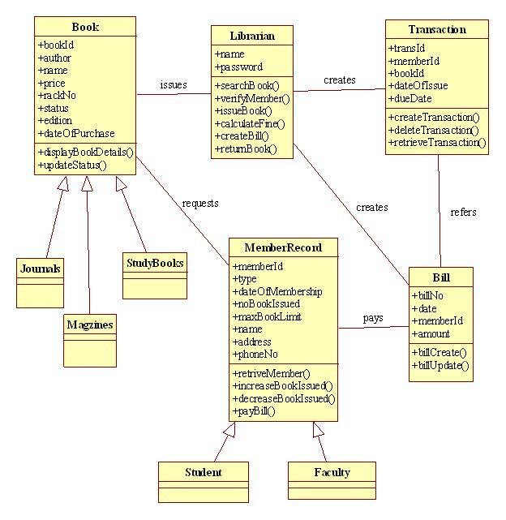
Class Diagram

Slide 10

Thank you!

